Slide 1
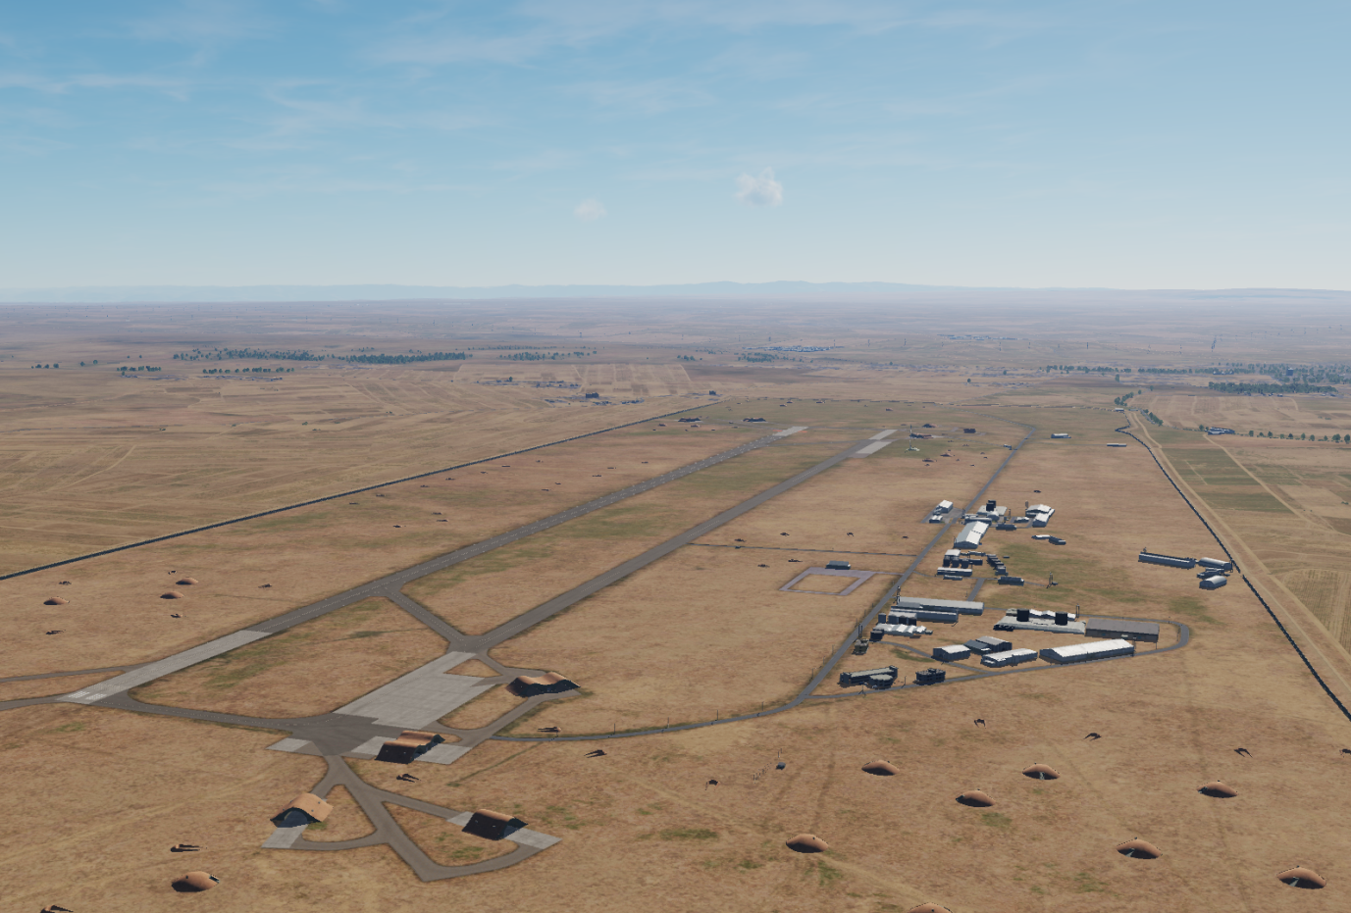

OPARTGT041 Abu al-Duhur Airbase
N
41
WEAPONEERING
DPI1 A: Primary fuel storage, 1x 500 Ibs bomb
DPI1 B: Primary fuel storage , 1x 500 Ibs bomb
DPI1 C: Primary fuel storage , 1x 500 Ibs bomb
DPI1 D: Primary fuel storage , 1x 500 Ibs bomb
DPI1 E: Primary fuel storage, 1x 500 Ibs bomb
DPI1 F: Primary fuel storage, 1x 500 Ibs bomb
DPI2 A: Secondary fuel storage, 1x 500 Ibs bomb
DPI2 B: Secondary fuel storage , 1x 500 Ibs bomb
DPI3: Primary ammo storage , 1x 500 Ibs bomb
DPI4: Secondary ammo storage , 1x 500 Ibs bomb
DPI5: Runway, 1x 500 Ibs bomb
DPI6: Runway, 1x 500 Ibs bomb
4
5
Abu al-Duhur Airbase: The target complex is supported by 2 fuel storages and 2 ammo storages.
EFFECTS:
Runway: Hits on runway will put the airbase out of action for 48 hours
Ammo storage: Hits on all storages will put the airbase out of action for 96 hours
Fuel storage: Hits on primary fuel storage will put the airbase out of action for 5 days. Hits on both secondary and primary storage will put the airbase out of action for 7 days.
6
7
8

Slide 2
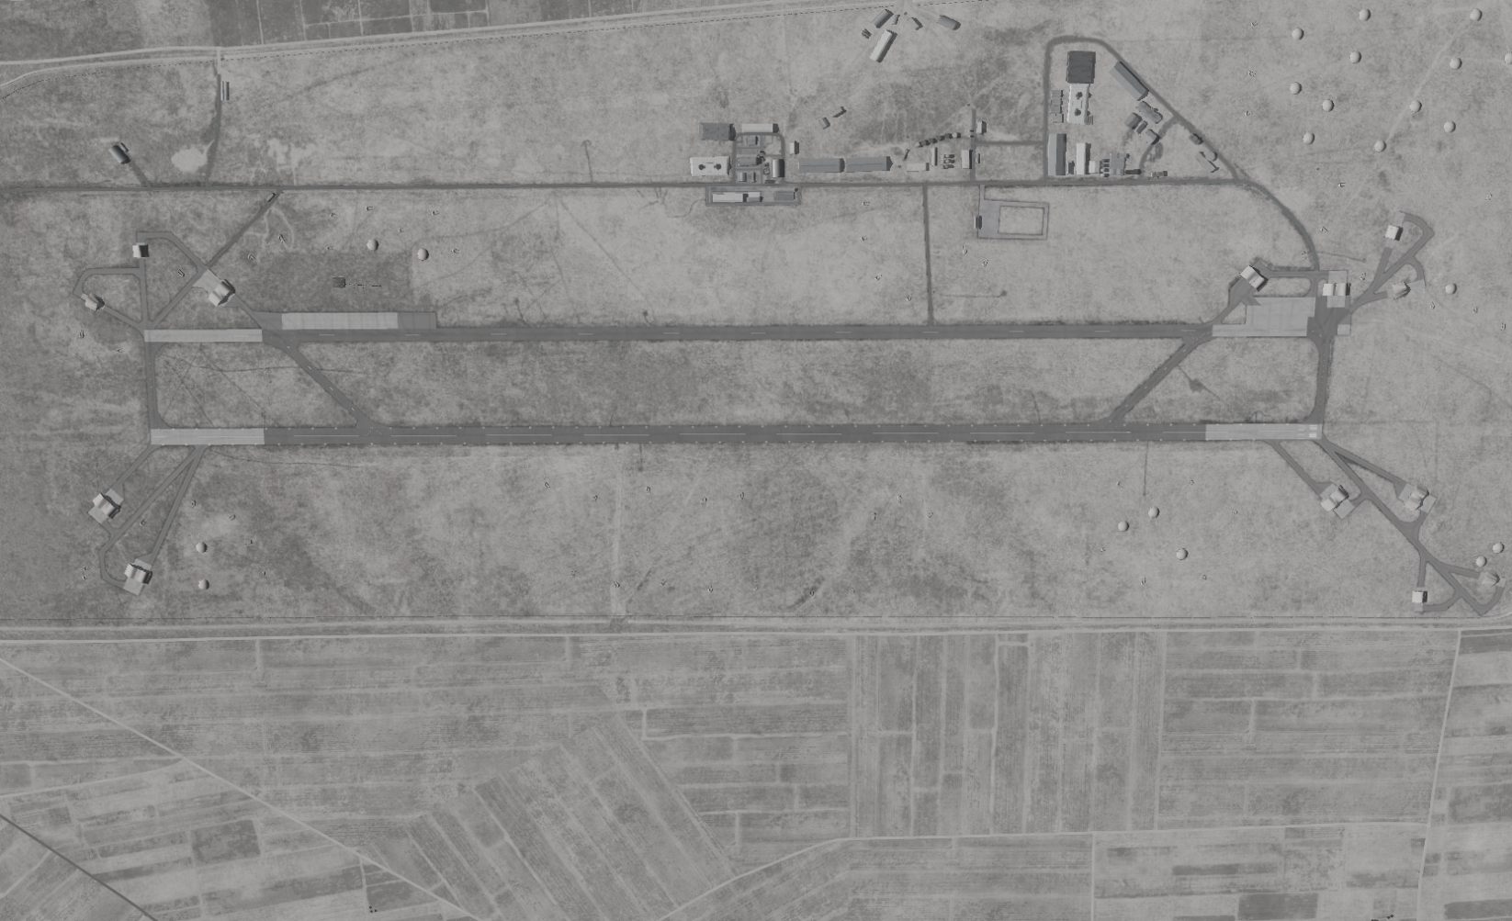
OPARTGT041 Abu al-Duhur Airbase
DPI’s relate to centre points of targets.
DPI1 A:N35 44.316 E037 06.567 810ft
DPI1 B:N356 44.317 E037 06.579 810ft
DPI1 C:N35 44.320 E037 06.590 810ft
DPI1 D:N35 44.322 E037 06.602 807ft
DPI1 E:N35 44.325 E037 06.617 807ft
DPI1 F:N35 44.325 E037 06.629 807ft
DPI2 A:N35 44 264 E037 06.912 820ft
DPI2 B:N35 44.264 E037 06.923 820ft
DPI3:N35 44.358 E037 05.257 707ft
DPI4:N35 44.433 E037 05.445 817ft
DPI5: N35 43.935 E037 06.330 820ft
DPI6: N35 44.074 E037 06.317 820ft
N
4
3
1
2
6
5
7
8

Slide 3
OPARTGT041 Abu al-Duhur Airbase
DPI’s relate to centre points of targets.
DPI1 A:
DPI1 B:
DPI1 C:
DPI1 D:
DPI1 E:
DPI1 F:
DPI2 A:
DPI2 B:
DPI3:
DPI4:
DPI5:
DPI6:
N
7
8

